Slide 1

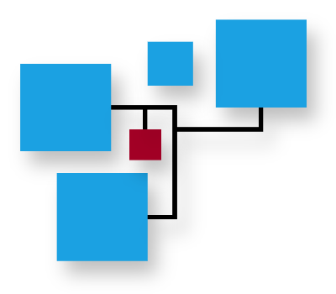
Tiny-vGamba: Distilling Large Vision-(Language) Knowledge from CLIP into a Lightweight vGamba Network
2nd Workshop on Efficient Computing under Limited Resources: Visual Computing
Yunusa H. Adamu L. Ismail A.
Abdulganiyu A. Y.
NewraLab
Suzhou, China

Slide 2
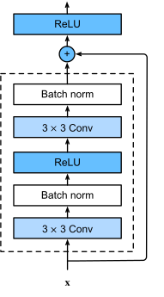
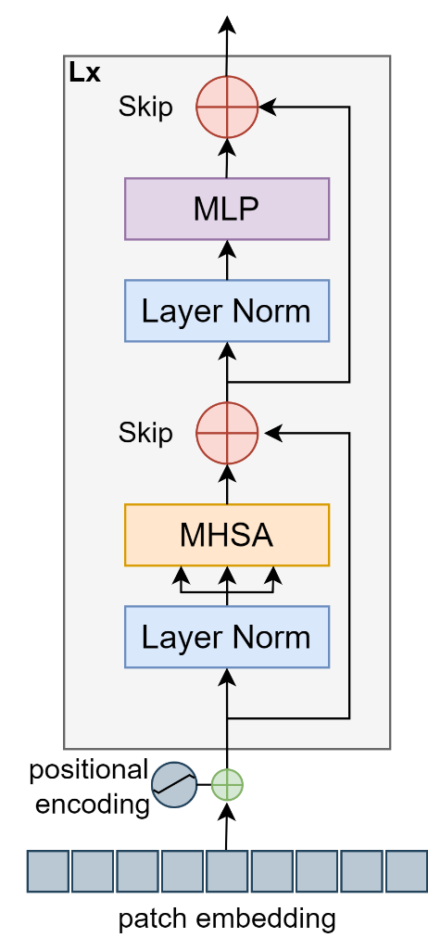
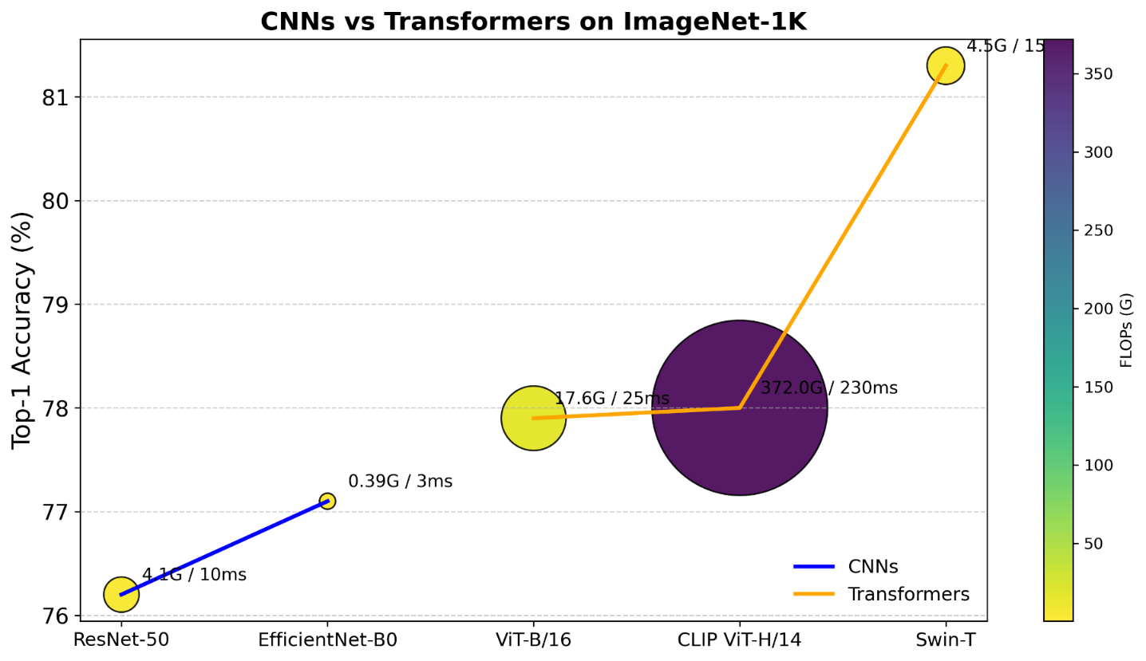
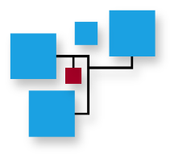
Problem. Deploying high-performing visual models on resource constrained edge devices remains a challenge due to the computational demands of architectures like Vision Transformers (ViT) and large vision-language models such as CLIP (Contrastive Language-Image Pre-training).
CNN FLOPs = Ω(H · W)
Scales quadratically
ViT FLOP = Ω((H · W / P²)²) Scales quadratically
ResNet [1]
ViT [2]
Dilemma to solve…
NewraLab

Slide 3
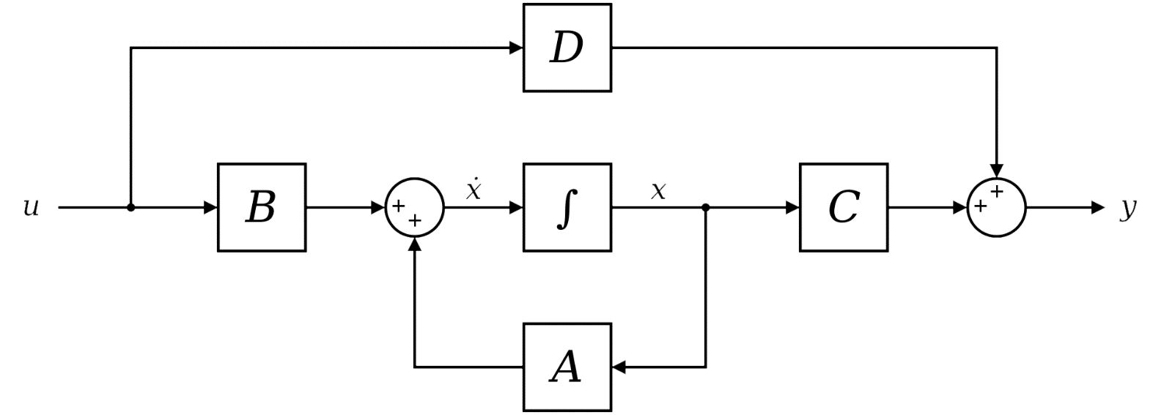
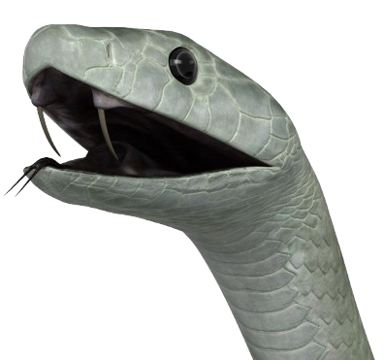
Then what’s next? Mamba State-space model
SSM FLOPs per step = Ω(n² + n·m + n·p)
SSMs model sequential data using hidden states that evolve over time:
xₜ = A · xₜ₋₁ + B · uₜ + wₜ yₜ = C · xₜ + D · uₜ + vₜ
inputs: uₜ; outputs: yₜ; state matrices: A, B, C, D; noise: wₜ, vₜ
Recursive state estimation: x̂ₜ = A · x̂ₜ₋₁ + B · uₜ
Mamba Discretization.
Continuous parameters discretized via zero-order hold:Aₜ = exp(Δ · A), Bₜ = (Δ · A)⁻¹ · (exp(Δ · A) - I) · B
Enables fast computation of Aₜ, Bₜ, Cₜ on GPUs.
Mamba [3]
NewraLab

Slide 4
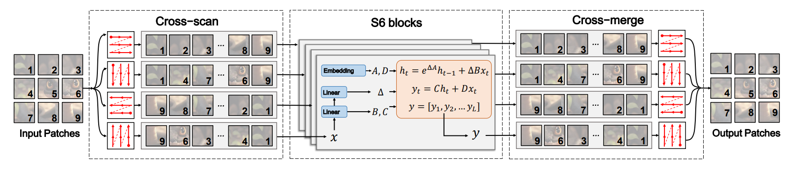
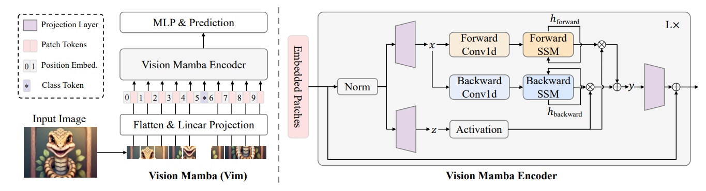
Adaptation for Visual tasks
Cross-scan & merge method VMamba [4]
Bi-directional ViM [5]
NewraLab
Notes:
Auto-regressive tasks

Slide 5
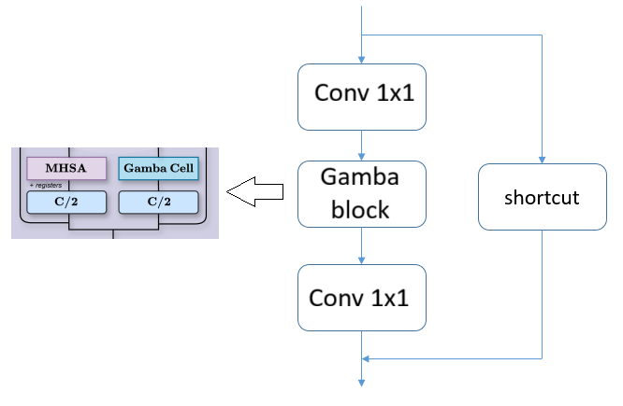
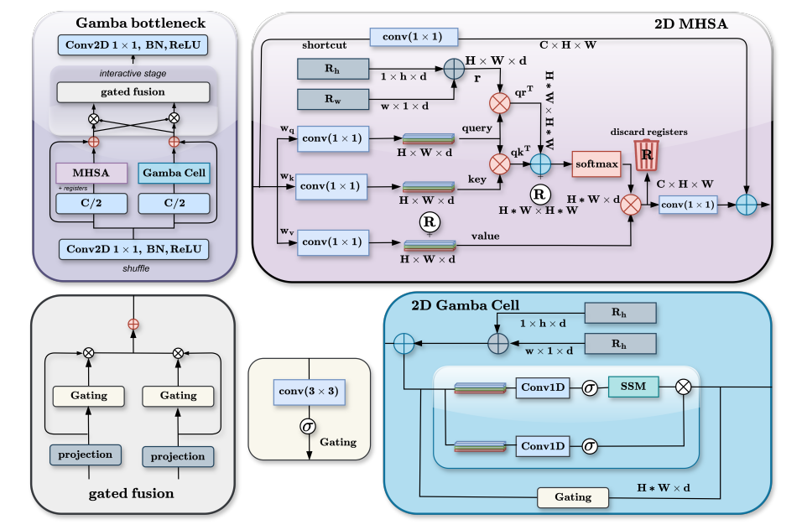
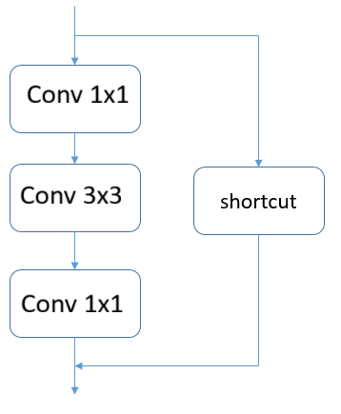
Contd.
Gamba bottleneck
Spatial context & 2D-positional embedding VGamba [6]
ResNet Bottleneck
NewraLab

Slide 6
What problem are we trying to solve?
Problem statement. Large-scale models like CLIP achieve strong semantic generalization but are too heavy for edge deployment. Lightweight CNN backbones, while efficient, lack the ability to model long-range dependencies and global context.
Gap. We address this gap with Tiny-vGamba, a compact backbone that distills visual knowledge from CLIP (ViT-B/32) and integrates CNN efficiency with a Mamba-based state-space module for lightweight, semantically rich inference on edge devices
Goal. Develop a lightweight visual recognition backbone that inherits CLIP’s strong semantic understanding, optimized for edge deployment.
NewraLab

Slide 7
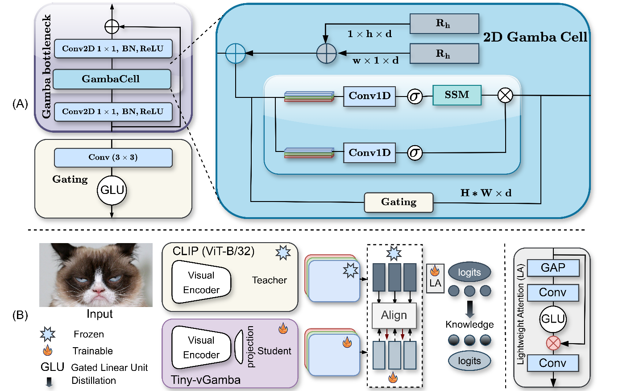
Architectural Modification Tiny-vGamba
Our Approach (Tiny-vGamba):
Combines CNN efficiency + Mamba-based state-space modeling for long-range dependencies.
Distills visual knowledge from a frozen CLIP (ViT-B/32) encoder.
Consists of three key modules:
Adapted Gamba bottleneck for low-latency inference
Feature & logit distillation from CLIP
Statistical feature alignment + lightweight attention
NewraLab

Slide 8
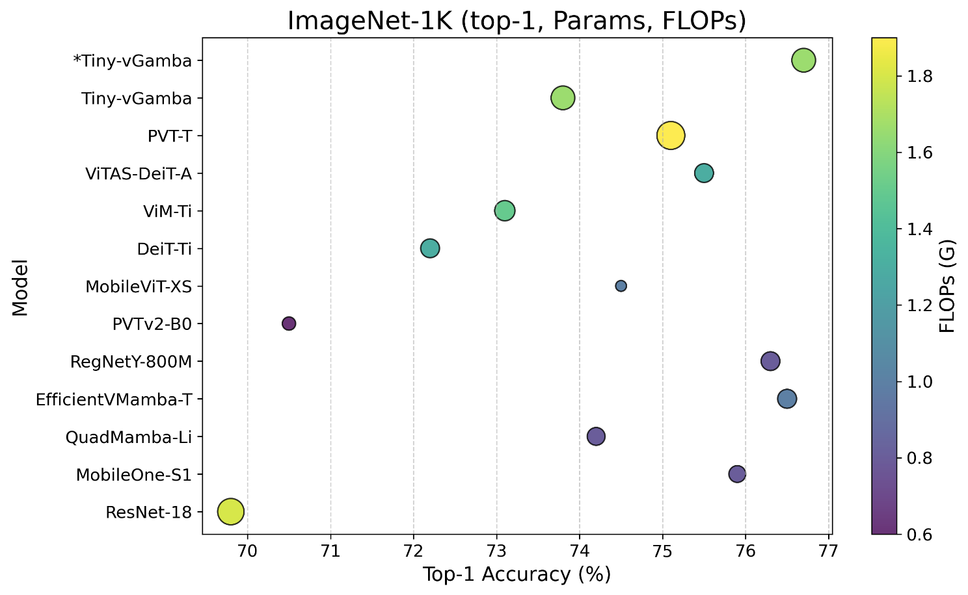
Quantitative on IMAGENET-1K
Baseline: ResNet-18 (69.8%) #Params: 11.8M: 1.8G Flops
w/o distillation: Tiny-vGamba (73.8%) (+4.0) #Params: 9.56M (-2.24): 1.66GFlops (-0.14)
w/* distillation: Tiny-vGamba (76.7%) (+2.9) #Params: 9.56M: 1.66GFlops
NewraLab

Slide 9
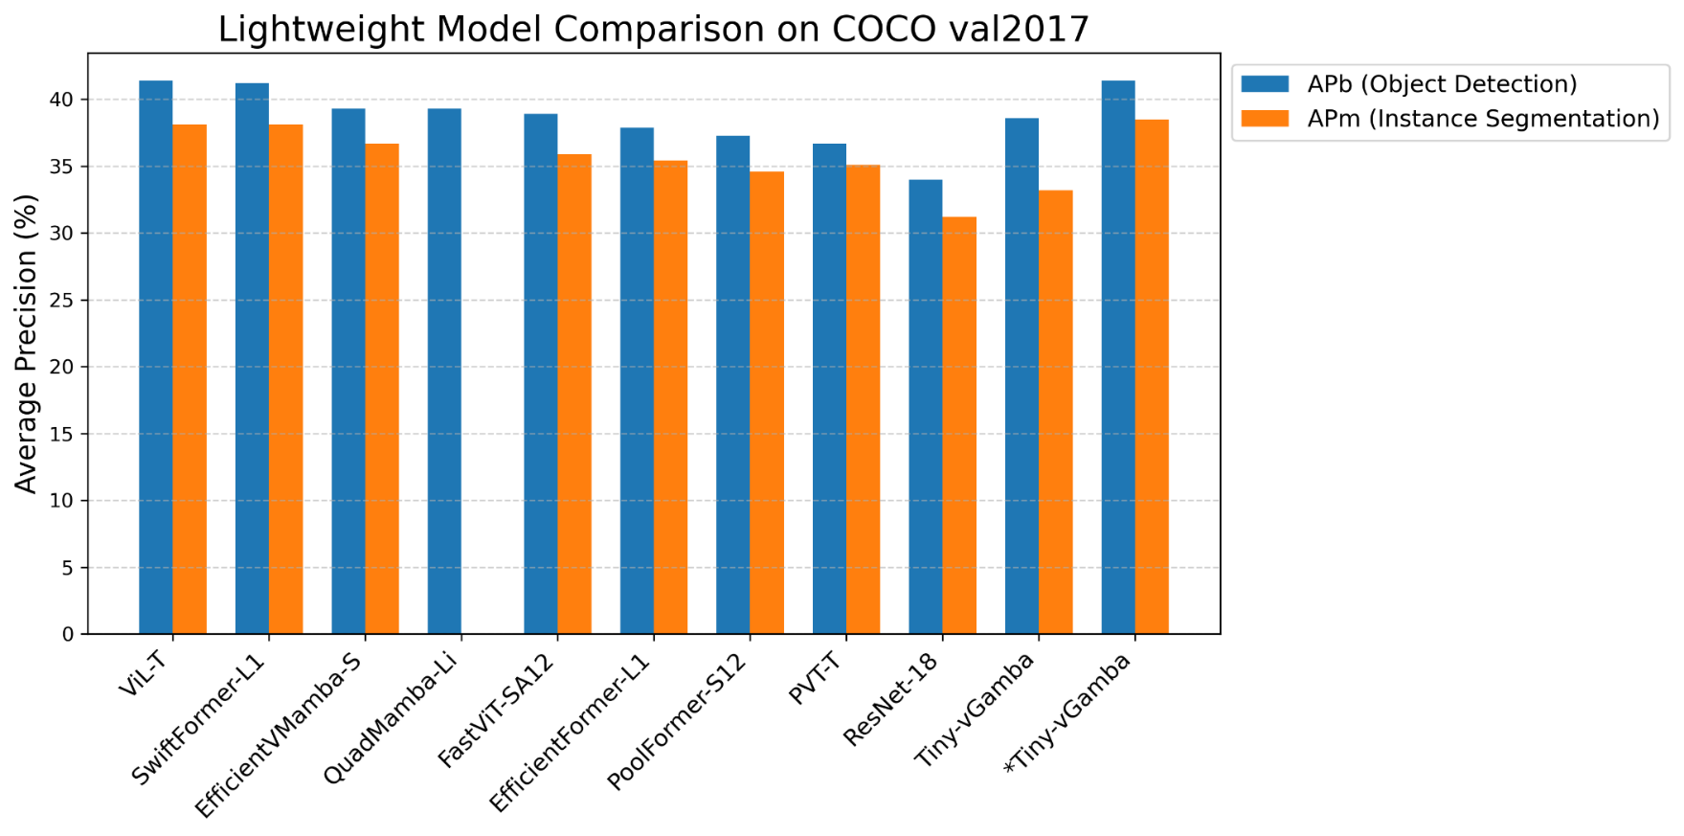
Object Detection COCO dataset
SOTA Comparison: EfficientVMamba-S (AP box 39.3) (AP mask 36.7) #Params: 197M: Gflops: 31G
w/o distillation: Tiny-vGamba (AP box 38.6 (-0.7)) (AP mask 33.2 (-3.5)) #Params: 206M: Gflops: 31
w/* distillation: Tiny-vGamba (AP box 41.4 (+2.1)) (AP mask 38.5 (+1.8)) #Params: 206M: Gflops: 31
NewraLab

Slide 10
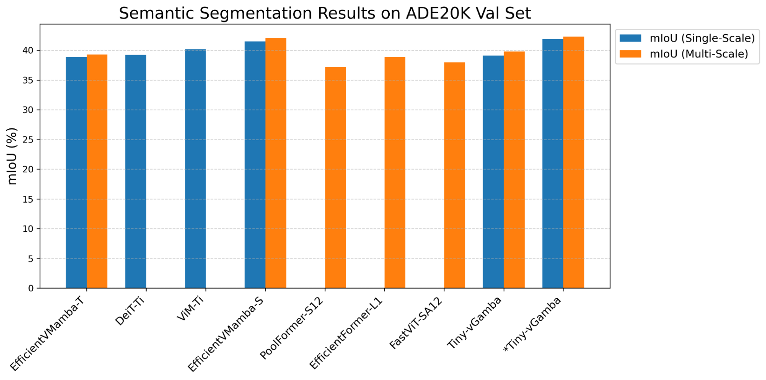
Semantic Segmentation on ADE20K
SOTA Comparison: EfficientVMamba-S (mIoU SS (41.5)) mIoU MS (42.1) #Params: 197M: Gflops: 31G
w/o distillation: Tiny-vGamba (mIoU SS (39.1 (-2.4)) (mIoU MS (39.8(-2.3) #Params: 603M: Gflops: 28
w/o distillation: Tiny-vGamba (mIoU SS (41.9(+0.4)) (mIoU MS (42.3 (+0.2)) #Params: 603M: Gflops: 28
NewraLab

Slide 11
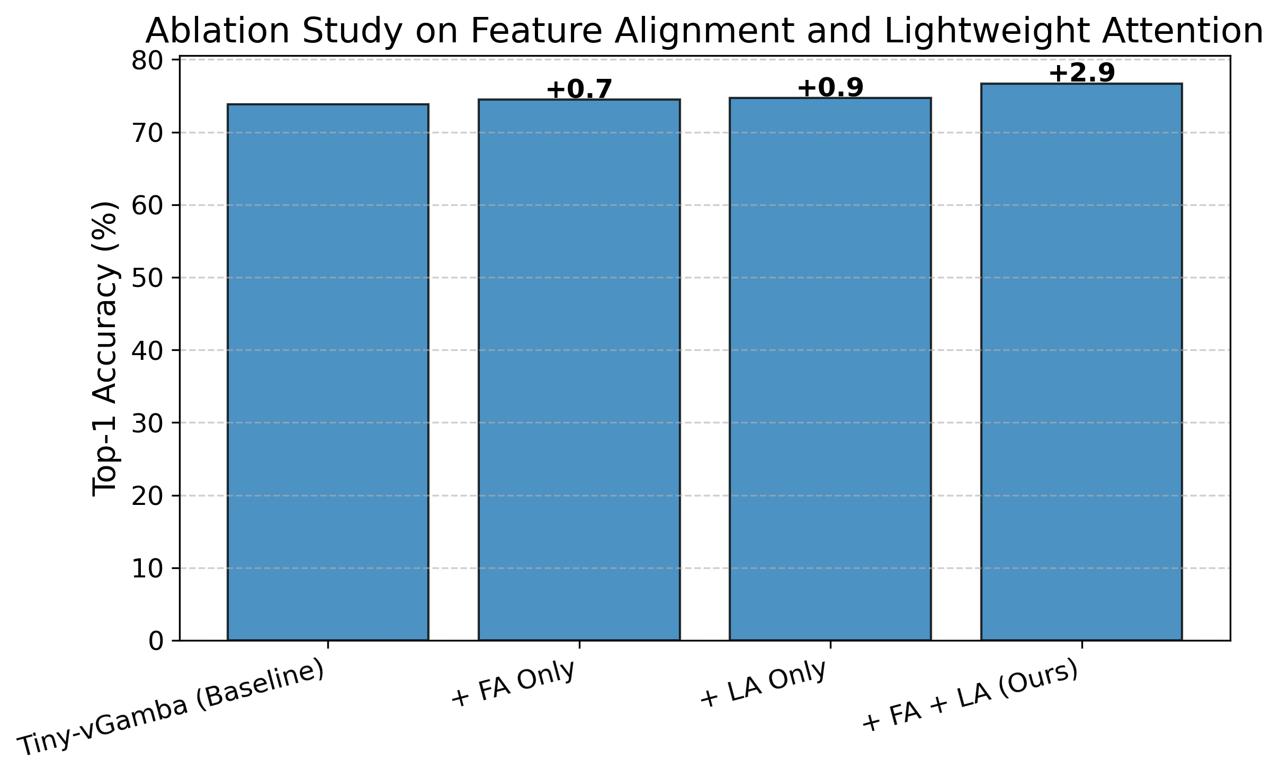
Lightweight Attention and feature alignment
NewraLab

Slide 12
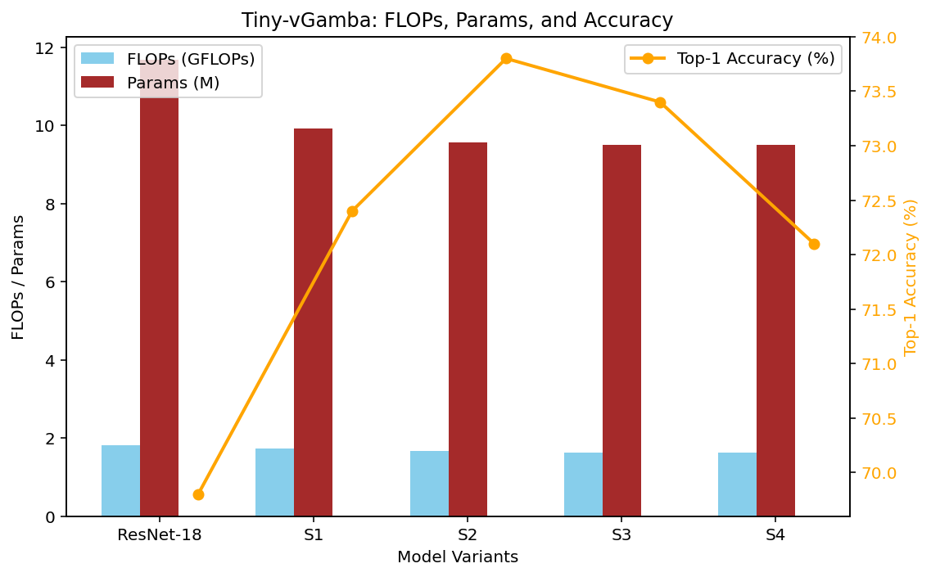
Efficiency evalution
ResNet-18: 69.8%
S1: Replace the last block only: 72.4%
S2: Replace the last two blocks: 73.8%
S3: Replace the last three blocks: 73.4%
S4: Replace all blocks: 72.1%
NewraLab

Slide 13
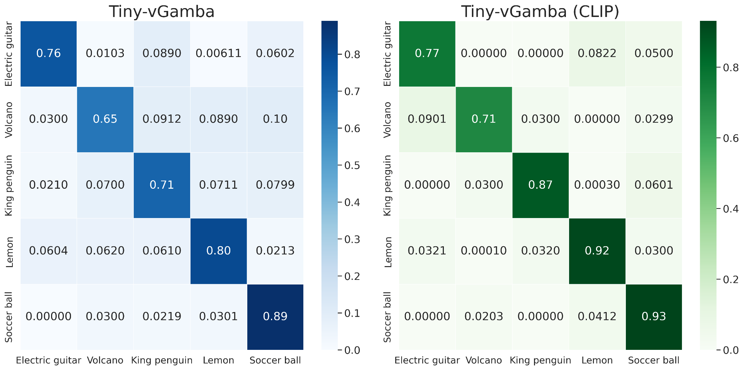
Confusion matrix IMAGENET-1K
NewraLab

Slide 14
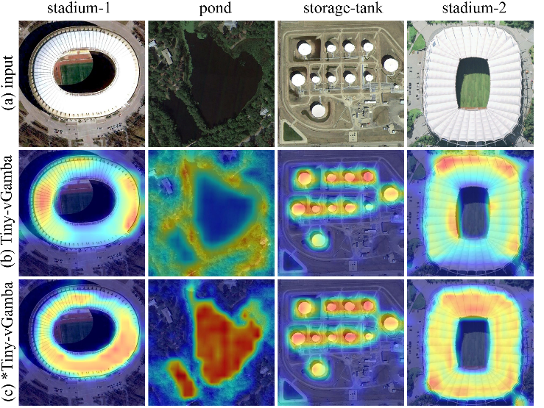
Qualitative results
Hi-ResCAM to visualize heat maps on Aerial Image Dataset.
NewraLab

Slide 15
References
He, Kaiming, Xiangyu Zhang, Shaoqing Ren, and Jian Sun. "Deep residual learning for image recognition." In Proceedings of the IEEE conference on computer vision and pattern recognition, pp. 770-778. 2016.
Dosovitskiy, Alexey. "An image is worth 16x16 words: Transformers for image recognition at scale." arXiv preprint arXiv:2010.11929 (2020).
Zhu, Lianghui, Bencheng Liao, Qian Zhang, Xinlong Wang, Wenyu Liu, and Xinggang Wang. "Vision mamba: Efficient visual representation learning with bidirectional state space model." arXiv preprint arXiv:2401.09417 (2024).
Liu, Yue, Yunjie Tian, Yuzhong Zhao, Hongtian Yu, Lingxi Xie, Yaowei Wang, Qixiang Ye, Jianbin Jiao, and Yunfan Liu. "Vmamba: Visual state space model." Advances in neural information processing systems 37 (2024): 103031-103063.
Gu, Albert, and Tri Dao. "Mamba: Linear-time sequence modeling with selective state spaces." In First Conference on Language Modeling. 2024.
NewraLab

Slide 16
Thank you for listening
Questions
NewraLab

